Slide 1

TGS Salt Identification Challenge
Data Science Capstone
Jeremy Lawson, Data Scientist
December 2018

Slide 2
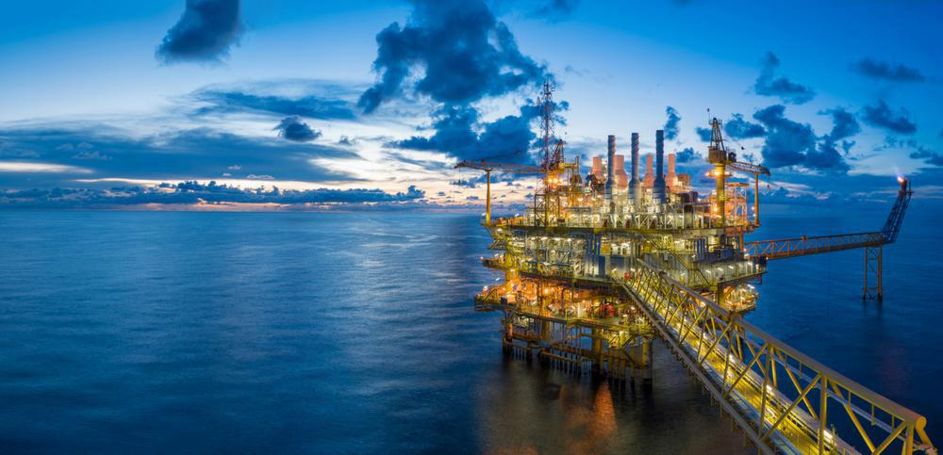
BackGround
Several areas of Earth with large accumulations of oil and gas also have huge deposits of salt below the surface.
But unfortunately, knowing where large salt deposits are precisely is very difficult. Professional seismic imaging still requires expert human interpretation of salt bodies.
This leads to very subjective, highly variable renderings. More alarmingly, it leads to potentially dangerous situations for oil and gas company drillers

Slide 3
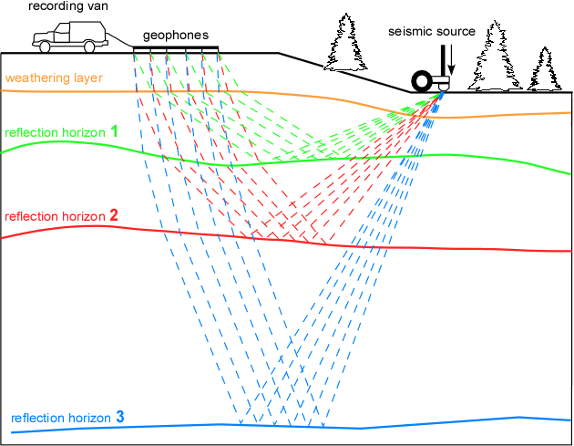
Reflection Seismology
Notes:
Seismic data is collected using reflection seismology, or seismic reflection. The method requires a controlled seismic source of energy, such as compressed air or a seismic vibrator, and sensors record the reflection from rock interfaces within the subsurface. The recorded data is then processed to create a 3D view of earth’s interior. Reflection seismology is similar to X-ray, sonar and echolocation.
A seismic image is produced from imaging the reflection coming from rock boundaries. The seismic image shows the boundaries between different rock types. In theory, the strength of reflection is directly proportional to the difference in the physical properties on either sides of the interface. While seismic images show rock boundaries, they don't say much about the rock themselves; some rocks are easy to identify while some are difficult
There are several areas of the world where there are vast quantities of salt in the subsurface. One of the challenges of seismic imaging is to identify the part of subsurface which is salt. Salt has characteristics that makes it both simple and hard to identify. Salt density is usually 2.14 g/cc which is lower than most surrounding rocks. The seismic velocity of salt is 4.5 km/sec, which is usually faster than its surrounding rocks. This difference creates a sharp reflection at the salt-sediment interface. Usually salt is an amorphous rock without much internal structure. This means that there is typically not much reflectivity inside the salt, unless there are sediments trapped inside it. The unusually high seismic velocity of salt can create problems with seismic imaging.

Slide 4

Evaluation Criteria for competition
This competition is evaluated on the mean average precision at different intersection over union (IoU) thresholds.
The metric sweeps over a range of IoU thresholds, at each point calculating an average precision value. The threshold values range from 0.5 to 0.95, with a step size of 0.05.
In other words, at a threshold of 0.5, a predicted object is considered a "hit" if its intersection over union with a ground truth object is greater than 0.5
Notes:
A true positive is counted when a single predicted object matches a ground truth object with an IoU above the threshold. A false positive indicates a predicted object had no associated ground truth object. A false negative indicates a ground truth object had no associated predicted object. The average precision of a single image is then calculated as the mean of the above precision values at each IoU threshold

Slide 5
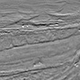
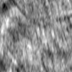
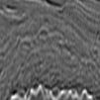
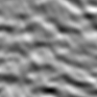
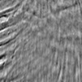
Data Understanding
The data is a set of images chosen at various locations, chosen at random in the subsurface.
The images are 101 x 101 pixels and each pixel within each image is classified as either salt or sediment. In addition to the seismic images, the depth of the imaged location is provided for each image in a csv file.
The goal of the competition is to segment regions that contain salt.

Slide 6
Modeling
Language: Python
Framework: Keras
Encoder: Resnet34 encoder
Input Image size: 101x101
10 epochs for each stage
Batch size = 32, min_LR = .0001
An 80-20 split of the train data is used for training and validation of the model.
To increase the size of the training dataset, the training data is augmented by including images (and masks) that have been flipped along the x-axis
Notes:
U-net model is built using a Resnet34 encoder and a standard decoder for semantic segmentation of images.
The 34 is how many layers are in the network. Resnet34 shown here https://i.imgur.com/nyYh5xH.jpg 31. Larger networks can model more complex problems, but at the risk of over fitting. You would need more regularization for larger networks. The reason why resnet34 is used is because its performance to accuracy trade off is fine for the problem. Larger networks would take longer to train, and use more memory than smaller networks.

Slide 7
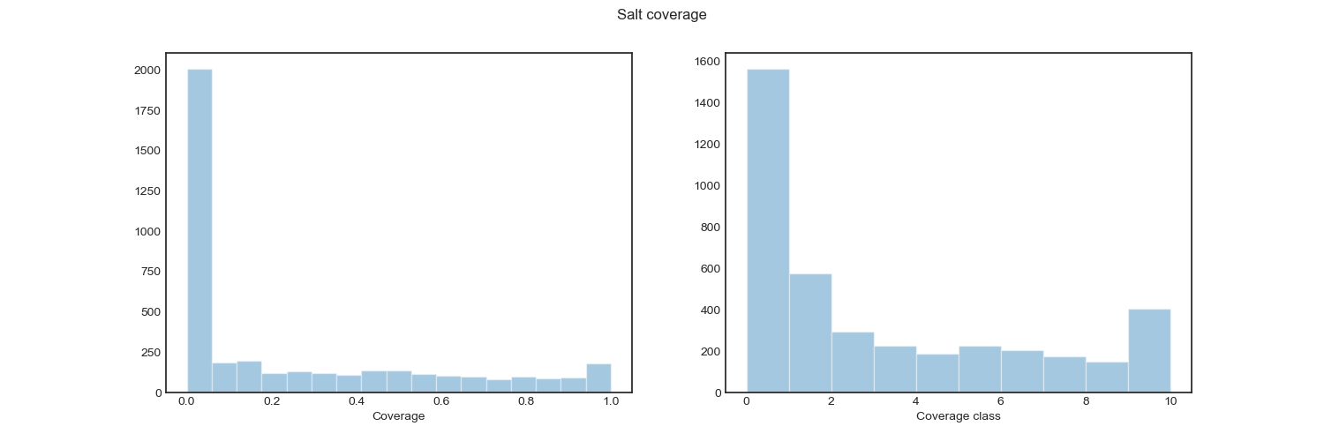
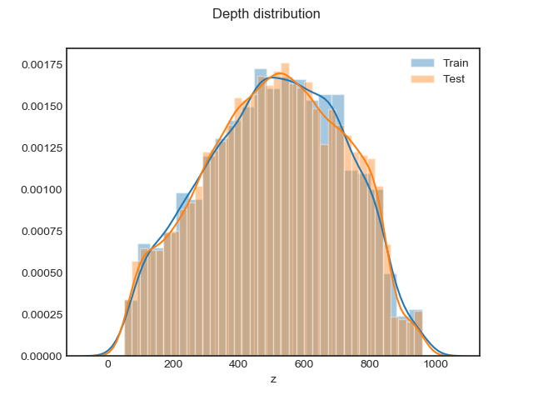
Modeling
Figure 1 and 2 show description of the Salt Coverage and the Depth Distribution from the datasets provided.
Notes:
Visualizing the Class Coverage – have been put in bins
Depth Distribution – Distribution of Depth of each image between the test and train files, there is more files at depth of 700 in the train than in the test set.
Counting the number of salt pixels in the masks and dividing them by the image size. -0.1 having no salt at all to 1.0 being salt only. Plotting the distribution of coverages and coverage classes, and the class against the raw coverage.

Slide 8
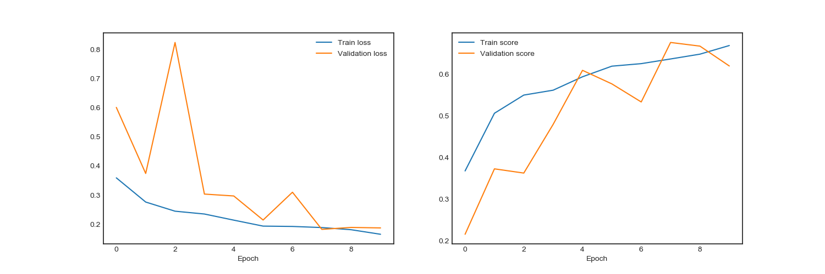
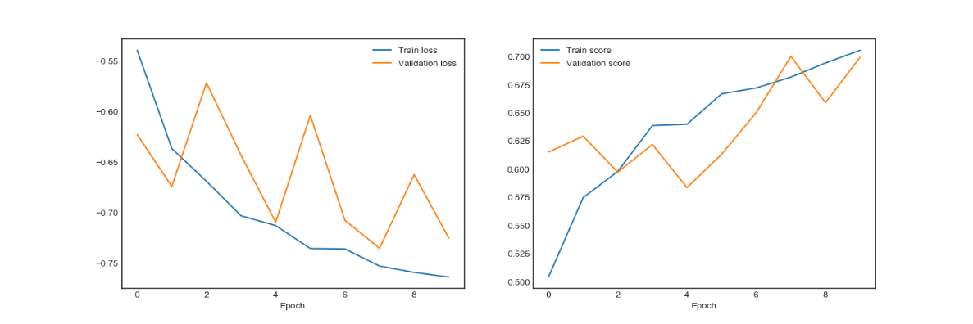
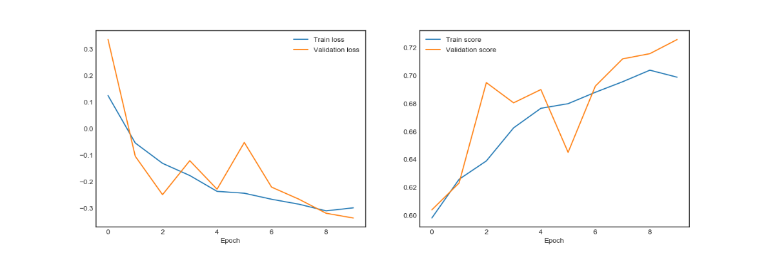
Evaluation Results
Training Overview:
Optimizer:
The Adam optimizer
Loss:
Binary-cross entropy
Binary-cross entropy plus dice loss
Binary-cross entropy plus dice loss plus mean squared error.
Notes:
The Adam optimizer is used to the train the model using a sequence of loss functions starting with the binary-cross entropy, binary-cross entropy plus dice loss, and finally the binary-cross entropy plus dice loss plus mean squared error.
The objective of introducing these different loss functions is to gradually move the set of weight parameters to a part of weight-space where the masks can be better reproduced. In a way the sequential use of loss functions acts as a form of regularization.
mean squared error, defined below. This function computes the difference between predicted and actual values, squares the result (which makes all of the values positive), and then calculates the mean value

Slide 9
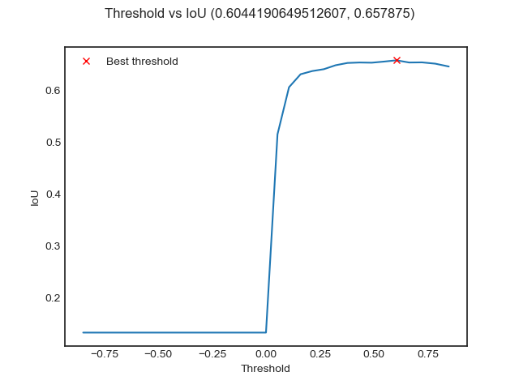
Evaluation results
Intersection over Union(IoU) threshold values in the range 0.5 to 0.95
Notes:
Since the performance of the model for this competition was evaluated in terms of the mean of the precision over a range of Intersection over Union(IoU) threshold values in the range 0.5 to 0.95, these values were evaluated for each IoU threshold and the optimal threshold value estimated from the validation data.
#Score the model and do a threshold optimization by the best IoU. ## Scoring for last model, choose threshold by validation data

Slide 10
Evaluation results
Total params: | 5,119,857
Trainable params: | 5,112,497
Non-trainable params: | 7,360
Stage 1 Ending Results
Epoch 8/10 | val_my_iou metric | 0.68
Epoch 9/10 | Val_my_iou metric | 0.67
Epoch 10/10 | Val_my_iou metric | 0.62
Stage 3 Ending Results
Epoch 8/10 | val_my_iou metric | 0.71
Epoch 9/10 | Val_my_iou metric | 0.72
Epoch 10/10 | Val_my_iou metric | 0.73
Notes:
Trained on 6400 samples, validated on 800 samples

Slide 11
Evaluation results
Submission Results from Kaggle Competition
Model | Private Score | Public Score
U-net Model | 0.685521 | 0.647333
The IoU metric improved with each stage in the code however it did not get above 70% when ran against the full test dataset for the competition.

Slide 12

Limitation
Total run time = 21.081168919139436 hours for one iteration
Determining what is a signal

Slide 13

Thank you!
Please Contact Jeremy Lawson at
Lawson.JeremyR@gmail.com
Notes:
Activation Function: ReLu
Pros
It avoids and rectifies vanishing gradient problem.
ReLu is less computationally expensive than tanh and sigmoid because it involves simpler mathematical operations.
Cons
One of its limitation is that it should only be used within Hidden layers of a Neural Network Model.
Some gradients can be fragile during training and can die. It can cause a weight update which will makes it never activate on any data point again. Simply saying that ReLu could result in Dead Neurons.

